Slide 1
Senate Bill 1383
Commercial Business Requirements
Corey Beavers
Public Works Department
November 1, 2021
Notes:
Good evening all, thank you all for coming tonight. My name is Corey Beavers and I work for the City of Fairfield Public Works Department. I am joined this evening with Sandra Gonzalez and Kevin Flanagan with Republic Services, along with Lisa Coelho with R3 Consulting. Tonight, we will be discussing a new state law, Senate Bill 1383, and ways your businesses can comply with SB 1383 requirements. We will begin with a short presentation about the history of California’s solid waste mandates and the goals of Senate Bill 1383. We will then discuss how your business can comply with new SB 1383 mandates and your requirements as businesses owners, before concluding with a question-and-answer segment.
(NEXT SLIDE)

Slide 2
History of California Solid Waste Legislation
AB 939 – Integrated Waste Management Act
AB 32 – Global Warming Solutions Act
AB 341 – Mandatory Commercial Recycling
AB 1826 – Mandatory Commercial Organics Recycling
SB 1383 – Reducing Short-lived Climate Pollutants
Notes:
For the sake of time, we won’t discuss too deeply into what has already transpired, but the State of California leads the nation in energy efficiency standards and has long had a series of legislative bills pertaining to solid waste management prior to Senate Bill 1383.
Starting in 1989, Assembly Bill 939, Integrated Waste Management Act, was the first of many unfunded state mandates and required that all jurisdictions divert 25% of solid waste from landfills through source reduction, recycling, and composting. This diversion percentage was increased to 50% in January 2000. The City of Fairfield currently meets this 50% diversion through programs such as our source separated curbside collection programs. When I say source separation, I am referring to separating materials by type at the point of discard so they can be recycled.
AB 32, Global Warming Solutions Act, enacted in 2006, required that greenhouse gas emissions be reduced to 1990 levels by 2020 to fight the impacts of global warming/climate change.
AB 341, Mandatory Commercial Recycling, enacted in 2012, requires businesses that generate four cubic yards or more of commercial solid waste per week, or multi-family properties of five or more units, to subscribe to recycling services. AB 341 focused on traditional recyclables such glass, metal, plastics, and cardboard. The main goals of AB 341 were to divert recyclable materials from landfills as a method to reduce greenhouse gas emissions and to expand recycling services and manufacturing facilities.
AB 1826, Mandatory Commercial Organics Recycling, enacted in 2016 and revised September 2020, required businesses and multi-family properties that generate two or more cubic yards of solid waste to subscribe to organics collection service. Organics include green waste, yard waste and food waste.
Which leads us to the most recent bill and the focus of tonight’s meeting, Senate Bill 1383, Reducing Short-lived Climate Pollutants.
(NEXT SLIDE)

Slide 3
SB 1383 Goals and Overview
SB 1383 signed into law in 2016, regulations finalized in 2020
Goes into effect starting January 1, 2022
Sets statewide targets for reductions in organics waste disposal and edible food recovery efforts to combat climate change
Requires all generators be provided organic waste recycling services
Unfunded State mandate
Notes:
SB 1383, was signed into law in 2016, regulations were finalized in 2020. SB 1383 is considered to be the most significant waste reduction mandate to adopted in California in the last 30 years and will result in numerous changes to local jurisdictions, haulers, and solid waste generators such as businesses and residents. SB 1383 builds upon previous California legislation related to solid waste, sustainability, and environmental regulation. SB 1383 requirements will go into effect starting January 1, 2022.
SB 1383 sets statewide targets to reduce organic waste disposal by 75% and to recover at least 20% of currently disposed surplus food for people to eat by 2025. Organic waste in the context of SB 1383 refers to green waste, wood waste, food waste and food soiled-paper.
The goals of SB 1383 organics diversion are largely two-fold: the first goal is to directly reduce the emissions of short-lived climate pollutants and subsequently help mitigate the effects of climate change. Landfilling organic waste leads to anaerobic breakdown of that material which creates short-lived climate pollutants and potent greenhouse gases such as methane. Reducing methane and other similar short-lived climate emissions is paramount in combating the impacts of climate change and air pollution.
The second goal of SB 1383 is to recover edible food from disposal to combat food insecurity/hunger in California. A CalRecycle study found that organic waste comprises nearly two-thirds of California’s total waste stream and food waste specifically composed about 18%, or six million tons, of the total waste stream in California.
To comply with SB 1383 mandates, ALL commercial businesses and residents must be provided with organic waste recycling services. Businesses and residents must comply with organic recycling services and will need to sign up for organic recycling service through Republic Services.
Again, I want to stress that this is an unfunded State mandate and SB 1383 regulations will impact all Californians.
(NEXT SLIDE)

Slide 4
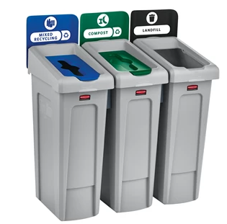
SB 1383 Commercial Business Compliance
Mandatory Organic Recycling Services
Provide access to carts to employees and customers
Provide education regarding sorting
Source separate materials
Monitor carts for contamination
Notes:
So, what does this all mean for businesses? The easiest way for businesses to comply with SB 1383 requirements and Fairfield Municipal Code Section 9.220 is to subscribe to organic waste recycling service with Republic Services. Republic Services provides curbside organic recycling service and businesses are strongly encouraged to contact Republic to sign up prior to January 1, 2022. Businesses will be provided a third container, a green toter style cart, for organics collection.
If your business currently uses a third-party landscaper to manage green waste, your business is compliant with only the green waste recycling requirement. However, SB 1383 requires that food waste/food-soiled paper also be diverted from landfill and your business may still be required to sign up for organic recycling services through Republic Services. Your business will be required to report the name of your landscaper and the amount of yard waste that your landscaper hauls.
In addition to signing up for organic recycling services, businesses must provide collection carts for organic waste and recyclables in all areas where trash carts are provided to employees, tenants, contractors and customers, except in restrooms. The carts must have a label or color to clarify their disposal stream. The picture on this slide is an example of container made by Rubbermaid that meets SB1383 requirements.
Businesses will be required to provide education to employees, contractors, tenants, and customers regarding how to properly sort organic material into the correct carts to reduce contamination. Contamination means that the wrong type of material was placed in the organics cart. Only yard waste, green waste, food waste, and food soiled paper are acceptable in the organics cart.
Lastly, businesses will be required to monitor carts for contamination and inform employees if carts are contaminated. Republic Services will also monitor carts for contamination during the collection process and will notify businesses if contamination is detected.
(NEXT SLIDE)

Slide 5
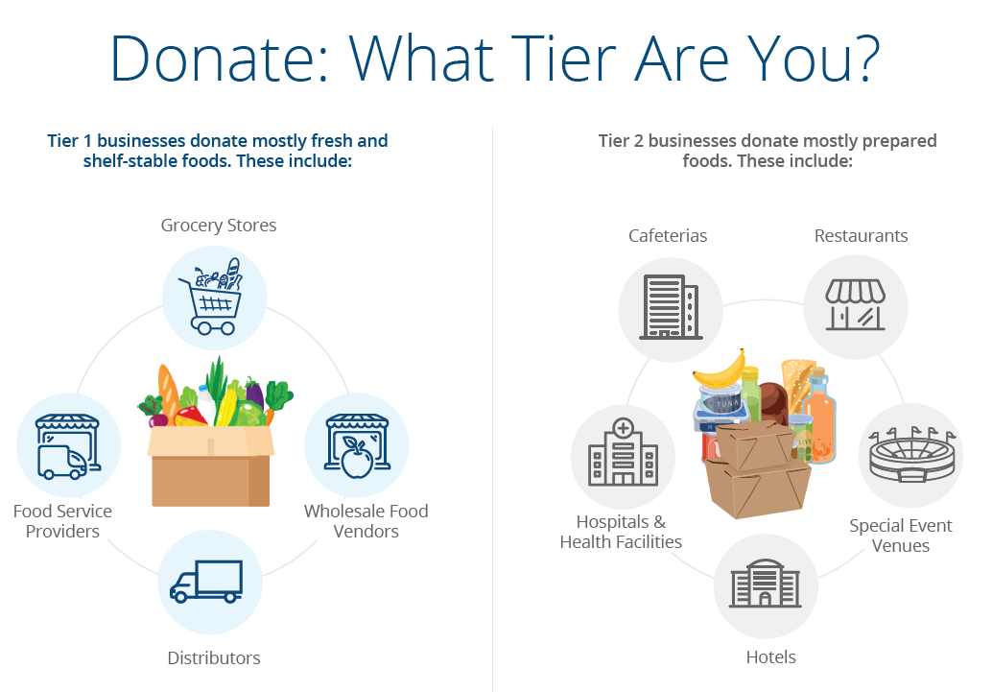
SB 1383 Edible Food Recovery Program
Commercial Edible Food Generators
Tier 1 Businesses
Grocery Stores
Wholesale Food Vendors
Distributors
Food Service Providers
Tier 2 Businesses
Cafeterias
Restaurants
Special Event Venues
Hotels
Hospitals and Health Facilities
Notes:
SB 1383 requires some commercial businesses to participate in an Edible Food Recovery Program. The City and Republic Services will contact businesses that will need to comply with Edible Food Recovery Program requirements separately either via phone or direct mail. If your business falls into any of the businesses categories shown either Tier 1 or Tier 2, please speak to either myself or Sandra after the presentation to see if your business needs to comply.
Tier 1 businesses include: Grocery Stores, Wholesale Food Vendors, Distributors, and Food Service Providers.
Tier 2 businesses include:
Cafeterias, Restaurants, Special Event Venues, Hotels, and Hospitals and Health Facilities.
Please note, that most restaurants will not need to comply, but again, please contact myself or Sandra if you have questions directly related to edible food recovery.
(NEXT SLIDE)

Slide 6
SB 1383 Rates and Fees
SB 1383 is an unfunded State law
The City of Fairfield is mandated by State law to implement SB 1383 programs and ensure that businesses comply
Organics recycling service through Republic Service will be a separate charge
Rates are based off total number of carts and frequency of service
Additional carts and pick-ups are more expensive
SB 1383 rates are still being finalized
Current rates for organics service may be subject to change
Business may be subject to penalties if not compliant with SB 1383 and Municipal Code
Notes:
As mentioned in previous slides, Senate Bill 1383 is an unfunded State mandate, and no funds or grants will be available to help businesses comply with requirements. The City understands that SB 1383 mandates may present financial hardship for businesses and will work with businesses to try to find solutions. However, the City of Fairfield is mandated by State law to implement SB 1383 programs and ensure that businesses and residents comply.
Organics recycling service through Republic Services will be a separate charge and businesses are strongly encouraged to contact Republic Services prior to January 1, 2022, to sign up to ensure compliance. This charge will be shown as a separate line item on your bill.
Organic recycling rates are based off the total number of carts and the frequency of pick-up service; additional carts and more frequent pick-ups will result in greater rates. Most businesses will be able to meet SB 1383 organics recycling services with 1 organics cart that is picked up 1 time per week, but businesses that generate more organic waste may be required to have additional carts and/or pick-ups.
SB 1383 rates are still being finalized and the current rates for organics service may be subject to change once rates are finalized. The City of Fairfield has consistently had lower rates than neighboring Cities and jurisdictions and strives to continue to offer competitive and cost-effective rates for both residents and businesses. Republic Services will notify businesses of any rate changes prior to implementation.
(NEXT SLIDE)

Slide 7
Exemptions and Waivers
SB 1383 regulations allows exemptions on a case-by-base basis
Exemptions granted in the past under AB 1826 will need to be renewed or may be revoked
Waivers by the City may be granted for:
De Minimis (§18984.11(a)(1))
Physical Space (§18984.11(a)(2))
Exemptions granted are good for 5 years, but subject to changes in law
Notes:
While SB 1383 is a statewide bill, SB regulations do allow Cities to grant exemptions on a case-by-case basis. However, these exemptions are uncommon and the vast majority of businesses will need to subscribe to organics recycling service as described in previous slides. Businesses should be prepared to subscribe to organics recycling services and comply with other SB 1383 requirements.
Under AB 1826, Mandatory Commerical Organic Recycling, your business may have applied for and/or been granted an exemption. However, due to changes in law and SB 1383 requirements, businesses that were previously granted an exemption will either need to renew (if applicable) or may have the exemption revoked. If your business was granted an exemption in the past and you wish to see if your excemption is still valid, please contact me after the meeting.
SB 1383 exemptions may be granted for either:
De Minimis Waivers.
(A) A jurisdiction may waive a commercial business’ obligation to comply with some or all of the organic waste requirements of this article if the commercial business provides documentation or the jurisdiction has evidence demonstrating that:
1. The commercial business’ total solid waste collection service is two cubic yards or more per week and organic waste comprises less than 20 gallons per week per applicable container of the business’ total waste.
2.The commercial business’ total solid waste collection service is less than two cubic yards per week and organic waste comprises less than 10 gallons per week per applicable container of the business’ total waste.
(2) Physical Space Waivers.
(A) A jurisdiction may waive a commercial business’ or property owner’s obligation to comply with some or all of the organic waste collection service requirements of this article if the commercial business or property owner provides documentation, or the jurisdiction has evidence from its staff, a hauler, licensed architect, or licensed engineer demonstrating that the premises lack adequate space for any of the organic waste container.
If you believe your business is eligible for exemption for either of these two reasons (De Minimis or Physical Space) please contact the City. Waivers will be issued on a case-by-case basis and will require a site visit by the City to verify if an exemption can be granted. We have exemption forms in the lobby if you are interested in applying.
(NEXT SLIDE)

Slide 8
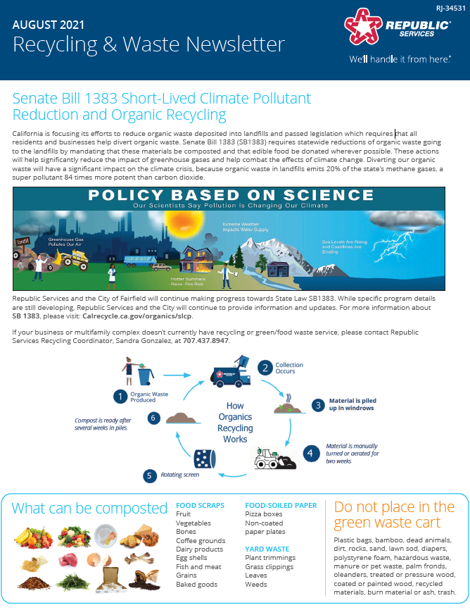
SB 1383 Resources and Assistance
Site visits
Flyers and pamphlets
Newsletters
Email and phone
cbeavers@fairfield.ca.gov | (707) 428-7528
sgonzalez4@republicservices.com | (707) 437-8947
Website
http://www.fairfield.ca.gov/recycling
https://www.republicservices.com/locations/california/fairfield
https://www.calrecycle.ca.gov/organics/slcp
Notes:
The City of Fairfield and Republic Services are here to help you and your business comply with SB 1383 requirements. If you have any questions about SB 1383, please reach out to us.
In addition to email and phone calls, the City and Republic Services are happy to provide:
Site Visits to your business to help teach employees about organic recycling and source separation
Flyers and pamphlets for you and your employees to help educate about SB 1383 requirements
Republic Services will continue to provide newsletters about SB 1383 and other programs that are available to you
And lastly, there is information available online at the City’s and Republic Services’ website, in addition to CalRecycle.

Slide 9
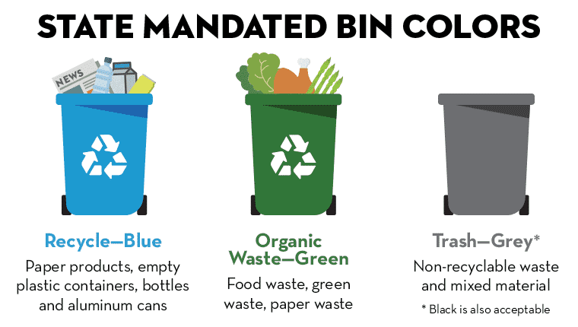
Questions-and-Answers
Notes:
Sandra, Lisa, and I will be happy to answer any questions you may have at this time regarding SB 1383 or organics recycling.

Slide 10
Senate Bill 1383 Commercial Business Requirements
Corey Beavers
Public Works Department
November 1, 2021
Notes:
This concludes my presentation, thank you again for your time this evening. If you have any additional questions, please feel free to contact myself or Sandra.

